Slide 1
Unit 5: Linked List
Compiled by:
Ghanashyam Bk

Slide 2

Introduction
a linear data structure that includes a series of connected nodes.
Or collection of objects called nodes that are randomly stored in the memory.
Here, each node stores the data and the address of the next node. For example,
You have to start somewhere, so we give the address of the first node a special name called HEAD.
Also, the last node in the linked list can be identified because its next portion points to NULL.

Slide 3
Linked List as an ADT
First() : Returns the address of the first node in the linked list so the other nodes to the right of it can be accessed.
Last() : Returns the address of the last node in the linked list so the other nodes to the right of it can be accessed.
Insertfirst() : Inserts a node at the front of the linked list.
Insertlast() : Inserts a node at the last of the linked list.
Insertbefore() : Inserts a node before the specified node’s position.
Insertafter() : Inserts a node after the specified node’s position.
Remove() : removes a node at the specified position.
Replace() : replaces a value stored at a position with some other value.
Swap() : swap the values of the nodes specified by two positions.

Slide 4

Types of Linked List
Singly Linked List
It is the most common. Each node has data and a pointer to the next node.
Doubly Linked List
We add a pointer to the previous node in a doubly-linked list.
Thus, we can go in either direction: forward or backward.

Slide 5

Types of Linked List
Circular Linked List
A circular linked list is a variation of a linked list in which the last element is linked to the first element. This forms a circular loop.
A circular linked list can be either singly linked or doubly linked.
for singly linked list, next pointer of last item points to the first item
In the doubly linked list, prev pointer of the first item points to the last item as well.

Slide 6
Applications of Linked List
Memory management:
We can use a linked list to keep track of portions of memory available for allocation.
Linked allocation of files:
A file of large size may not be stored in one place on a disk. So there must be some mechanism to link all the scattered parts of the file together. The use of a linked list allows an efficient file allocation method in which each block of a file contains a pointer to the file's text block.
Support for other data structures:
Some other data structures like stacks, queues, hash tables, graphs can be implemented using a linked list.
The cache in your browsers that allows you to hit back button (a linked list of state)
Undo functionality in Photoshop or word.

Slide 7
Advantages & Disadvantages of Linked List
Advantages of Linked List:
Linked list are dynamic data structure. That is, they can grow or shrink during the execution of a program.
Efficient memory utilization: Memory is allocated whenever it is required. And it is deallocated when it is not needed.
Data can be stored in non contiguous blocks of memory.
Insertion and deletion of nodes is easier.
Disadvantages of linked lists:
Needs extra space because each node has an extra link field.
Accessing a particular node in the list may take more time.

Slide 8
Singly Linked List
A singly linked list is a concrete data structure consisting of a sequence of nodes
Each node stores
Data
link to the next node
The very first node of the linked list is called Header node where nodata is stored, but holds the address of the very first data element.
The elements can be traversed from left to right. Hence, it is also called as one-way list.

Slide 9
Insert an item in Singly linked list
A node can be inserted into a singly linked list in any of the following three positions.
Insertion of a node at the front.
Insertion at the end.
Insertion at any position.

Slide 10
Insert an item in Singly linked list
Insertion of a node at the front.(Algorithm)
Allocate memory for new node
Store data
Change next of new node to point to head
Change head to point to recently created node
Pseudocode
struct node *newNode;
newNode = malloc(sizeof(struct node));
newNode->data = 4;
newNode->next = head;
head = newNode;

Slide 11
Insert an item in Singly linked list
Insertion at the end.(algorithm)
Allocate memory for new node
Store data
Traverse to last node
Change next of last node to recently created node
Pseudocode
struct node *newNode;
newNode = malloc(sizeof(struct node));
newNode->data = 4;
newNode->next = NULL;
struct node *temp = head;
while(temp->next != NULL){
temp = temp->next;
}
temp->next = newNode;

Slide 12
Insert an item in Singly linked list
Insertion at any position.
Allocate memory and store data for new node
Traverse to node just before the required position of new node
Change next pointers to include new node in between
Pseudocode
struct node *newNode;
newNode = malloc(sizeof(struct node));
newNode->data = 4;
struct node *temp = head;
for(int i=2; i < position; i++) {
if(temp->next != NULL) {
temp = temp->next;
}
}
newNode->next = temp->next;
temp->next = newNode;

Slide 13
Delete an item from Singly linked list
Delete from beginning
Point head to the second node
i.e. head = head->next;
Delete from end
Traverse to second last element
Change its next pointer to null
Delete from middle
Traverse to element before the element to be deleted
Change next pointers to exclude the node from the chain
Delete from end(Pseudocode)
struct node* temp = head;
while(temp->next->next!=NULL){
temp = temp->next;
}
temp->next = NULL;
Delete from middle (Pseudocode)
for(int i=2; i< position; i++) {
if(temp->next!=NULL) {
temp = temp->next;
}
}
temp->next = temp->next->next;

Slide 14

Doubly Linked Lists
A doubly linked list is a type of linked list in which each node consists of 3 components:
*prev - address the previous node.
data – data item
*next – address of next node
Fig: Representation of Doubly linked list

Slide 15
Insertion on a Doubly Linked List
Pushing a node to a doubly-linked list is similar to pushing a node to a linked list, but extra work is required to handle the pointer to the previous node.
We can insert elements at 3 different positions of a doubly-linked list:
Insertion at the beginning
Insertion in-between nodes
Insertion at the End

Slide 16
Insertion on a Doubly Linked List
Insertion at the Beginning
Create a New node
Allocate memory for new node
Assign the data to new node.
Set prev and next pointers of new node
Point next of new node to the first node of the doubly linked list
Point prev to null.
Make new node as head node
Point prev of the first node to new node (now the previous head is the second head)
Point head to new node.
Function to Insertion at the Beginning
void insertFront(struct Node** head, int data) {
struct Node* newNode = new Node;
newNode->data = data;
newNode->next = (*head);
newNode->prev = NULL;
if ((*head) != NULL)
(*head)->prev = newNode;
(*head) = newNode;
}

Slide 17
Insertion on a Doubly Linked List
Insertion in between two nodes
Create a new node
allocate memory for newNode
assign the data to newNode.
Set the next pointer of new node and previous node
assign the value of next from previous node to the next of newNode
assign the address of newNode to the next of previous node
Set the prev pointer of new node and the next node
assign the value of prev of next node to the prev of newNode
assign the address of newNode to the prev of next node
Function for Insertion in between two nodes
void insertAfter(struct Node* prev_node, int data) {
if (prev_node == NULL) {
cout << "previous node cannot be NULL";
return;
}
struct Node* newNode = new Node;
newNode->data = data;
newNode->next = prev_node->next;
prev_node->next = newNode;
newNode->prev = prev_node;
if (newNode->next != NULL)
newNode->next->prev = newNode;
}

Slide 18
Insertion on a Doubly Linked List
Function for Insertion at the End
void insertEnd(struct Node** head, int data) {
struct Node* newNode = new Node;
newNode->data = data;
newNode->next = NULL;
struct Node* temp = *head;
if (*head == NULL) {
newNode->prev = NULL;
*head = newNode;
return;
}
while (temp->next != NULL)
temp = temp->next;
temp->next = newNode;
newNode->prev = temp;
}
Insertion at the End
Create a new node
allocate memory for newNode
assign the data to newNode.
Assign null to next of new node
Set prev and next pointers of new node and the previous node
store the head node temporarily (for later use)
If the linked list is empty, make the newNode as the head node.
Otherwise, traverse to the end of the doubly linked list
point the next of the last node (temp) to newNode.
assign prev of newNode to temp

Slide 19
Deletion from a Doubly Linked List
Discused in class

Slide 20
Circular Linked List
Discussed in class

Slide 21
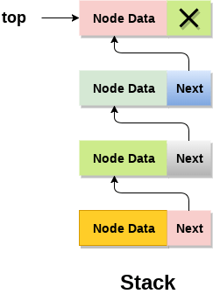
Linked Stacks
Instead of using array, we can also use linked list to implement stack.
Linked list allocates the memory dynamically.
In linked list implementation of stack, the nodes are maintained non-contiguously in the memory.
Each node contains a pointer to its immediate successor node in the stack.
Stack is said to be overflown if the space left in the memory heap is not enough to create a node.
The top most node in the stack always contains null in its address field.

Slide 22
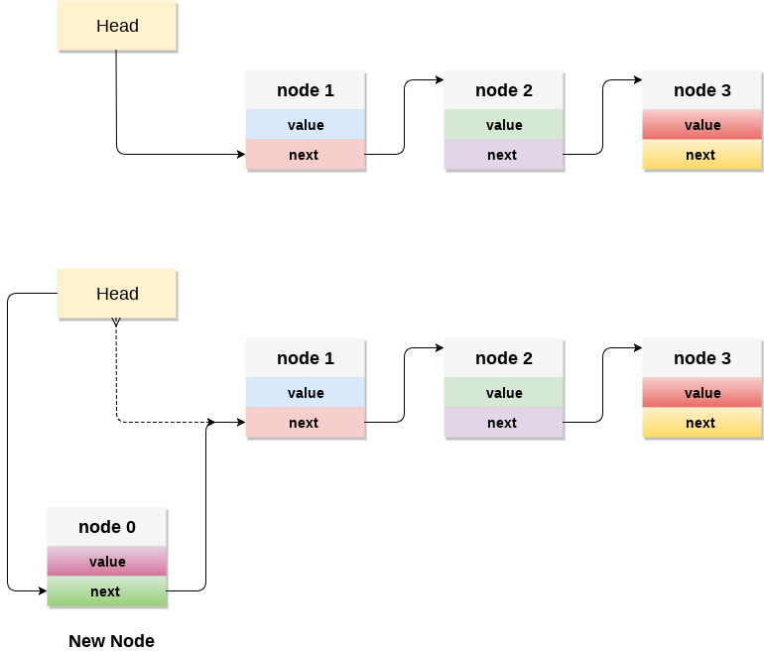
Linked Stacks

Slide 23
push() elements in stack using linked list
Elements can only be pushed at top of the stack.
Algorithm
Create a new node using dynamic memory allocation and assign value to the node.
Check if stack is empty or not, i.e, (top or head == NULL).
If it is empty, then set the next pointer of the node to NULL.
Else the newly created node should be linked to the current top element of the stack
the top of the stack should always be pointing to the newly created node.
void push(int value) {
struct Node *newNode;
newNode = (struct Node *)malloc(sizeof(struct Node));
newNode->data = value; // assign value to the node
if (top == NULL) {
newNode->next = NULL;
} else {
newNode->next = top; // Make the node as top
}
top = newNode; // top always points to the newly created node
printf("Node is Inserted\n\n");
}

Slide 24
pop() elements from stack using linked list
Elements are popped from top of the stack.
There should be at least one element in stack to perform pop() operation.
Algorithm
Check if stack is empty or not, i.e, (TOP == NULL).
If it is empty, then print Stack Underflow.
Else, create a temporary node and set it to top. Now, create another variable and copy the data of top element to this variable.
Now, make top point to the next node.
Delete the temporary node and return the value stored in temp_data.
int pop() {
if (top == NULL) {
printf("\nEMPTY STACK");
} else {
struct Node *temp = top;
int temp_data = top->data; //to store data of top node
top = top->next;
free(temp); //deleting the node
return temp_data;
}
}

Slide 25
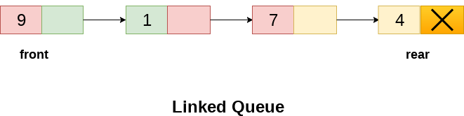
Linked Queue
array implementation can not be used for the large scale applications where the queues are implemented.
One of the alternative of array implementation is linked list implementation of queue.
In a linked queue, each node of the queue consists of two parts i.e. data part and the link part.
Each element of the queue points to its immediate next element in the memory.
In the linked queue, there are two pointers maintained in the memory i.e. front pointer and rear pointer.
The front pointer contains the address of the starting element of the queue while the rear pointer contains the address of the last element of the queue.

Slide 26
Insertion on a linked queue
Algorithm
Create a new node
Check if queue is empty i.e. front = NULL
If queue is empty, then the new node added will be both front and rear, and the next pointer of front and rear will point to NULL.
Else, make the next pointer of rear point to new node and point rear pointer to the newly created node
Hence, a new node(element) is added to the queue.
void insert(struct node *ptr, int item) {
ptr = (struct node *) malloc (sizeof(struct node));
if (ptr == NULL) {
printf("\nOVERFLOW\n"); return;
} else {
ptr -> data = item;
if (front == NULL) {
front = ptr;
rear = ptr;
front -> next = NULL;
rear -> next = NULL;
} else {
rear -> next = ptr;
rear = ptr;
rear->next = NULL;
}}}

Slide 27
Deletion on a linked queue
Algorithm
Check if the queue is empty or not
If the queue is empty, i.e, front==NULL, so we just print 'underflow' on the screen and exit.
Else, delete the element at which the front pointer is pointing. For deleting a node, copy the node which is pointed by the front pointer into the pointer ptr and make the front pointer point to the front's next node and free the node pointed by the node ptr.
void deleteNode (struct node *ptr) {
if (front == NULL) {
printf("Underflow");
return;
} else {
ptr = front;
front = front -> next;
free(ptr);
}
}

